Slide 1



MINI PROJECT (2020-21)
COVID_TRACKER
(Twitter Bot)
Institute of Engineering & Technology
Submitted by- Devashish Ranjan (181500213)
Supervised By: - Mr. Vinay Agarwal
Technical Trainer Department of Computer Engineering & Applications

Slide 2
Abstract
In this we will build a Twitter Bot using a python library called “Tweepy” to access twitter’s API. This twitter bot will reply the user whenever it will be mentioned with the latest COVID-19 stats depending on what hashtag has been provided by the user. As this bot can provide covid stats either worldwide or country-wide. If the user ends the tweet with a “#covid19” or “#covid_19” or “#coronavirus” (case insensitive) then the bot will reply with worldwide stats and if the user ends the tweet with a “#india” or “#brazil” or “#china” (any country name again case insensitive) then the bot will reply with the covid stats of that specific country. It doesn’t only reply to the tweet it likes and retweets that particular tweet as well. The bot takes the data that it replies to the user from “https://www.worldometers.info/coronavirus/” . It does this using some python web scraping libraries.

Slide 3

Introduction
In this project we have to build a Twitter Bot using a python library called “Tweepy” and some python web scraping libraries and then we will deploy it to a web server for hosting.
Tweepy
Tweepy is an open source Python package that gives you a very convenient way to access the Twitter API with Python. Tweepy includes a set of classes and methods that represent Twitter’s models and API endpoints, and it transparently handles various implementation details, such as:
• Data encoding and decoding
• HTTP requests
• Results pagination
• OAuth authentication
• Rate limits
• Streams
If you weren’t using Tweepy, then you would have to deal with low-level details having to do with HTTP requests, data serialization, authentication, and rate limits. This could be time consuming and prone to error. Instead, thanks to Tweepy, you can focus on the functionality you want to build.

Slide 4

As mentioned earlier some python web scraping libraries used in this project namely are:-
Requests
This is a simple and easy to use HTTP library for python which allows the user to efficiently send a request and connect to any website that you want after which you can request it for it’s content and so on.
Lxml
LXML is a pythonic, mature binding for the libxml2 and libxslt libraries . It provides safe and convenient access to these libraries using the ElementTree API.

Slide 5

Objective
The main objectives of this bot is to reply, retweet and like all the tweets that contain the twitter handle @project_tweepy with a hashtag that is either #covid19 , #covid_19 , #coronavirus or #country.The reply that the bot sends to the user contains in case of #covid19 , #covid_19 , #coronavirus is Total Cases , Active Cases, Non Active Cases, Recovered and total Deaths and in case of #country it is total cases, recovered cases and total deaths.
All of this to educate the user to please wear a mask and stay safe.

Slide 6
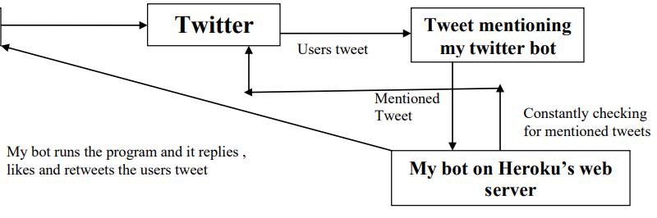
Working
User

Slide 7
Implementation
To implement this bot let’s divide the whole process into two parts:-
Creating the bot itself
Deploying the bot
Creating the bot
• Create the basic structure of the bot Which involves:-
i. Importing Tweepy
ii. Defining API keys(used for authentication purposes. These are provided when you make a twitter developer account.)
iii. Creating and initializing a authentication token (so that the API can authenticate you and provide you a stable connection with the twitter server)
• Process for scraping the data
i. Send a request to “https://www.worldometers.info/coronavirus/” to get a status code
ii. Initialize that status code to a variable
iii. Access the data of that webpage using the variable and format it into a XML tree(done using a method of requests library “html.fromstring(.content)”)
iv. Move through that tree using a method of lxml library called Xpath to get your desired content

Slide 8
Deployment of the bot
Choose a hosting service of your choice (I chose Heroku).
As here i have chosen Heroku as my hosting service so the process for deployment on Heroku is as follows :-
• Create a account on Heroku
• Create a new app
• Upload your code on Heroku’s server (this can be achieved through one of three ways available on heroku)
One of those ways is to upload your code to a github repository and then link your Heroku account to that repo
• Deploy your app

Slide 9
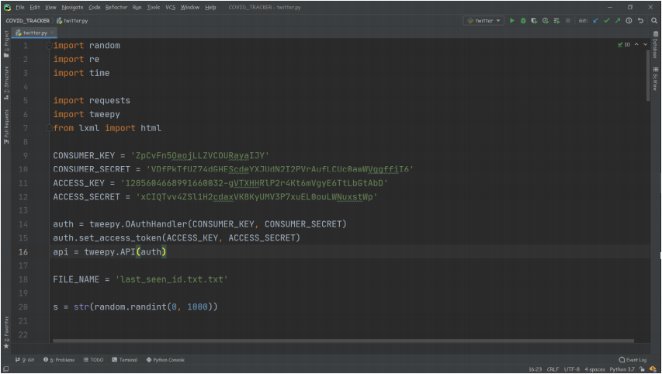
Implementation in code

Slide 10
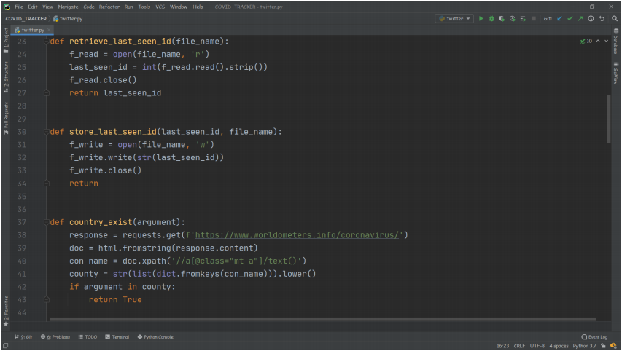

Slide 11
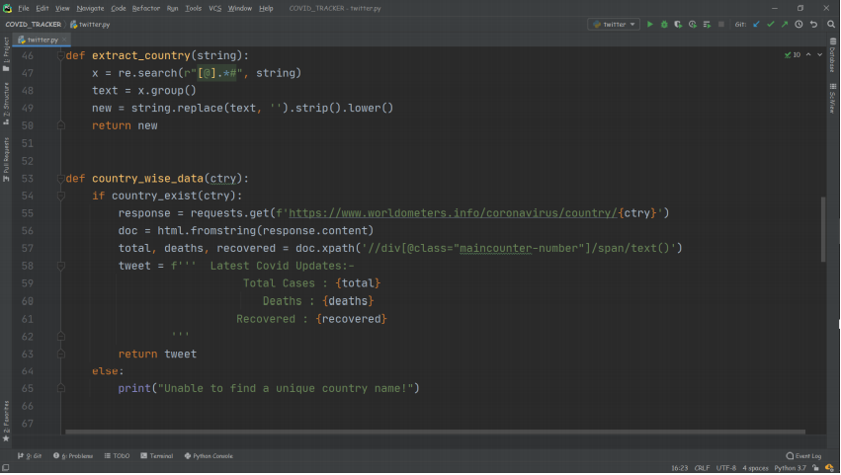

Slide 12
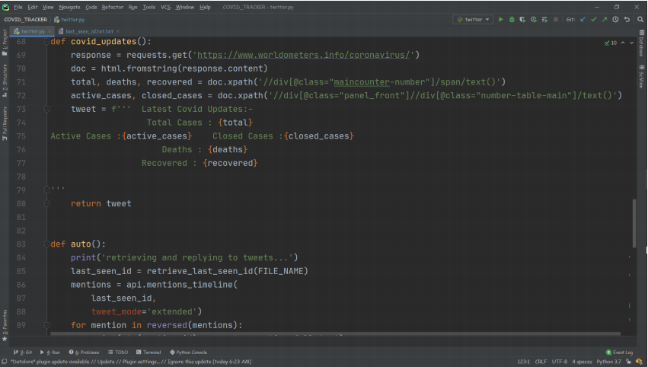

Slide 13
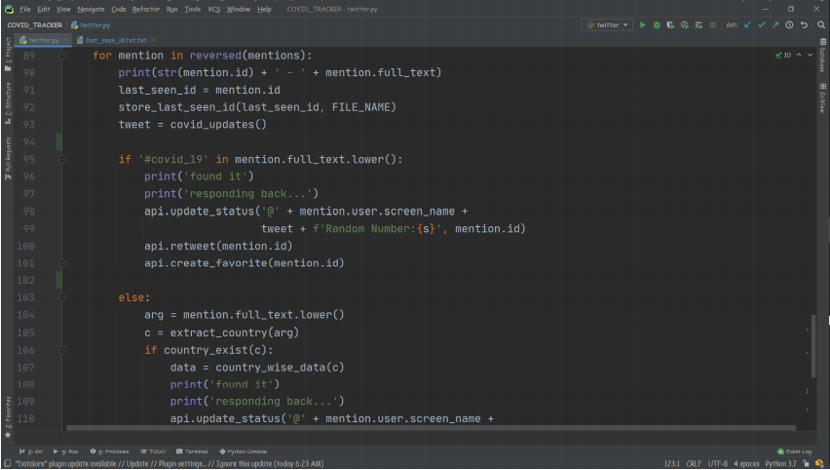

Slide 14
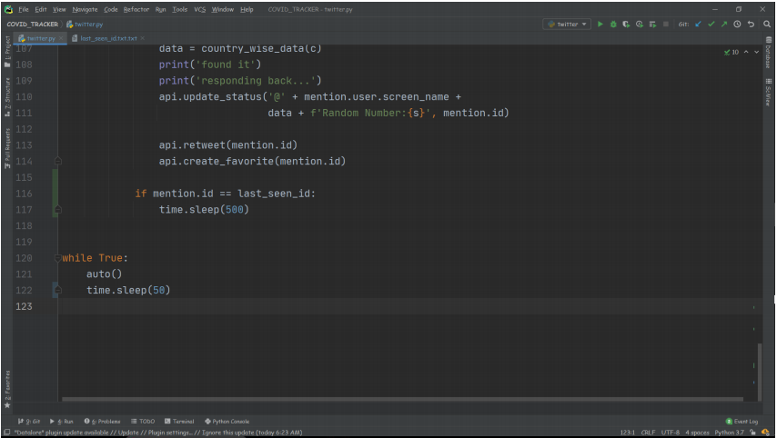

Slide 15
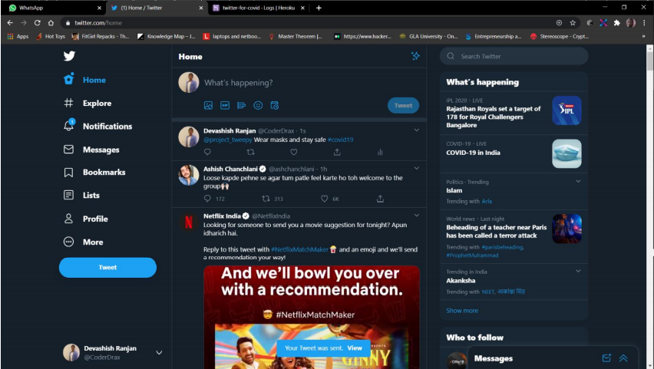
Working Screenshots

Slide 16
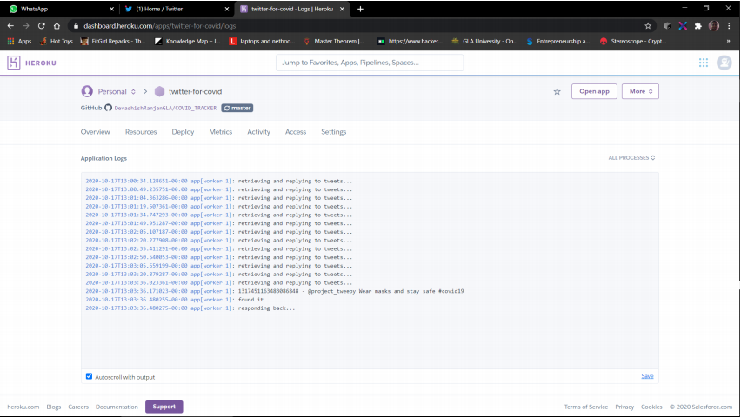

Slide 17
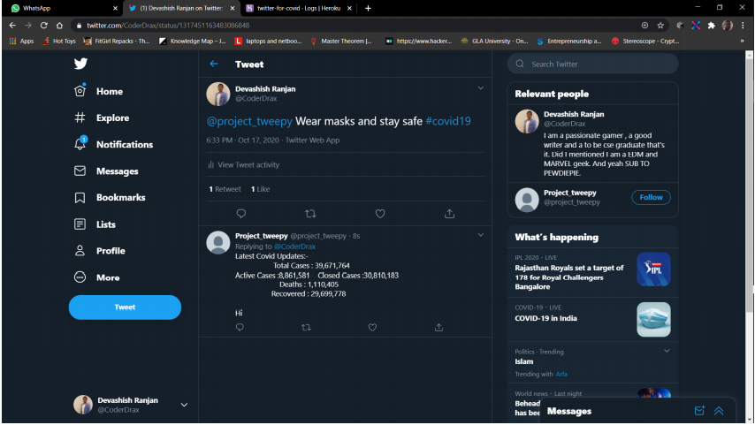

Slide 18
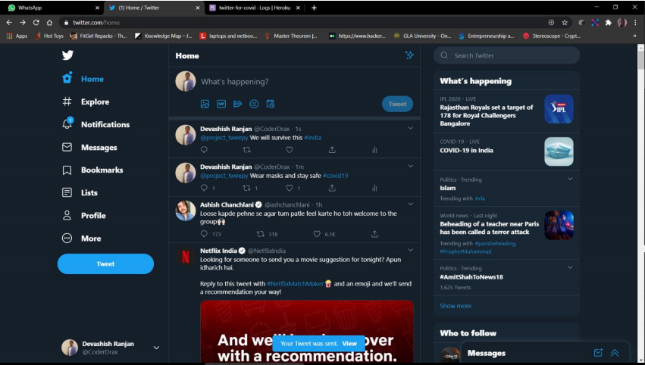

Slide 19
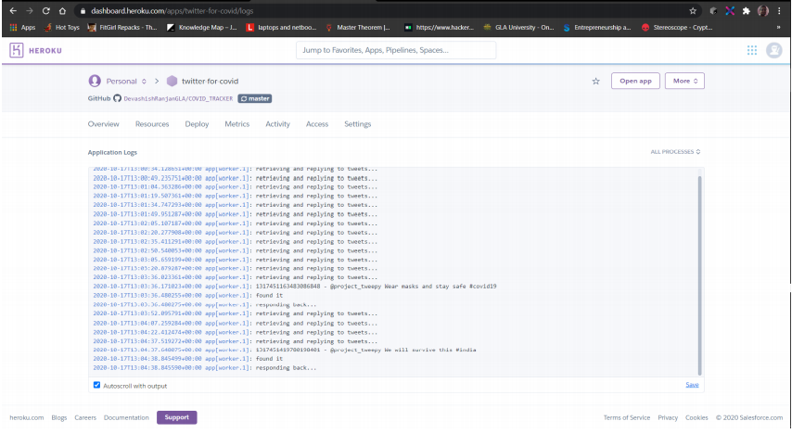

Slide 20
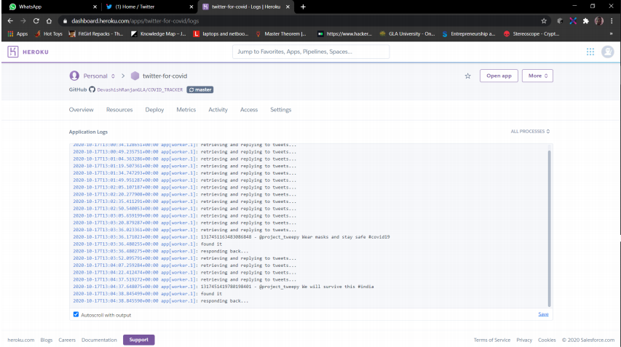

Slide 21
